Slide 1
EMBODIED AI · WEEK 22
Experiment 1: Standing Without AI
Every step I took, from a blank machine to the result
I re-ran this experiment from scratch to build this talk — new Miniconda, new environment,
new MuJoCo. Every terminal panel is the unedited output of the step it sits on.
Shaoqin Li · Prof. Yi Sun · CCNY

Slide 2
What I set out to answer
Can a humanoid robot stand up with no AI at all — and if so, what is it still unable to do?
Why this question is worth a whole experiment
1
Everyone assumes the hard part is the AI.
Before I train anything, I want to know exactly what a controller with no learning can already do.
2
It gives Experiment 2 a number to beat.
A learned policy is only impressive if I can say what it beat, measured the same way.
3
It is cheap.
Six minutes of laptop CPU, no GPU. I can afford to run it many times.

Slide 3
The ten steps
Four of these are setup. Six are the experiment. Each one gets a slide, with the screen I actually saw.
Install Miniconda
Run one good setting
1
6
get a Python I can control
make it stand once
Create an environment
Break it — weak spring
2
7
keep this project isolated
the robot topples
Install MuJoCo
Break it — heavy damping
3
8
the physics simulator
the simulator dies
Verify the install
Sweep all 49 settings
4
9
prove it works before trusting it
map where standing is possible
Get the robot model
Push it over
5
10
the R1, 26 bodies, 12 leg joints
find the limit I cannot tune away
grey = setting up the machine teal = running the experiment

Slide 4
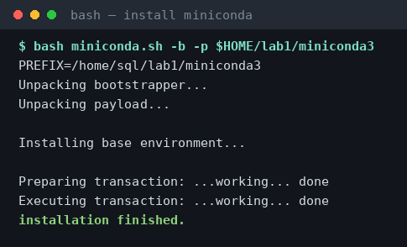
STEP 1 / 10
Install Miniconda
get a Python I can control
I installed Miniconda into my home folder. The -b flag runs it without prompts, -p says where to put it.
Takes about a minute. Nothing is added to the system Python — everything stays inside this one folder.

Slide 5
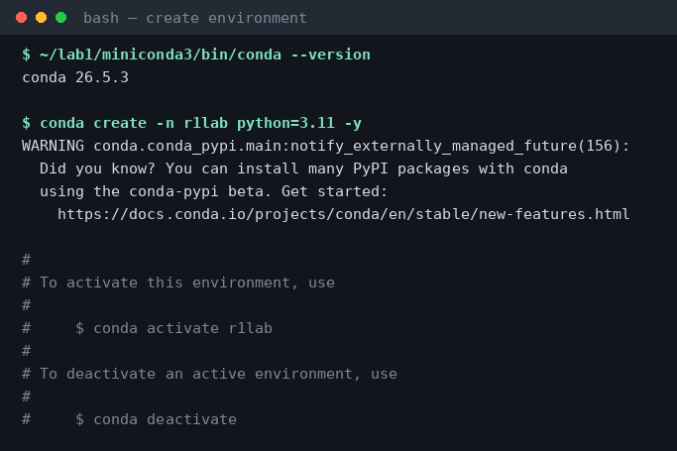
STEP 2 / 10
Create an environment
keep this project isolated
Then I made a dedicated environment for this project, with its own Python 3.11.
If I break something later, I delete the environment and start again. Nothing else on the machine is touched.

Slide 6
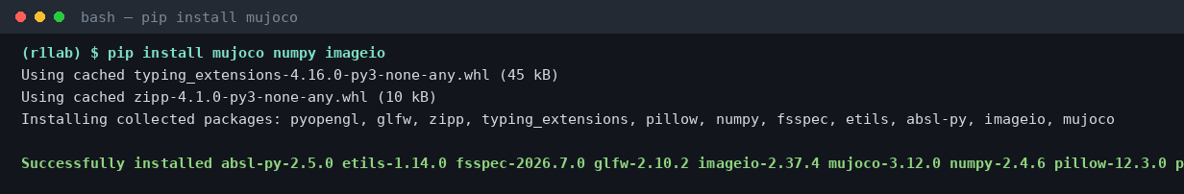
STEP 3 / 10
Install MuJoCo
the physics simulator
Three packages. MuJoCo is the physics engine, NumPy does the maths, imageio saves pictures.
About 70 MB total. Note what is NOT here: no PyTorch, no CUDA, no GPU driver.

Slide 7
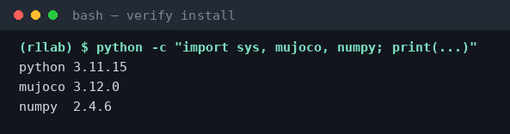
STEP 4 / 10
Verify the install
prove it works before trusting it
Before trusting any result, I check the versions actually import.
This is the habit that matters: prove the tool works BEFORE you use it to measure something.

Slide 8
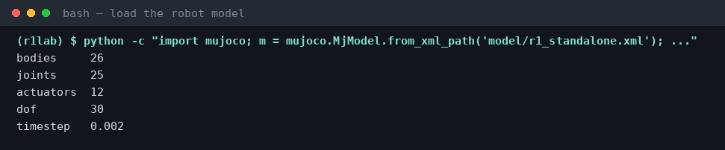
STEP 5 / 10
Get the robot model
the R1, 26 bodies, 12 leg joints
Then I loaded the R1 model and printed what MuJoCo thinks it is.
26 bodies, 12 things I can drive, and a timestep of 0.002 s — the simulator moves 500 times per second.

Slide 9
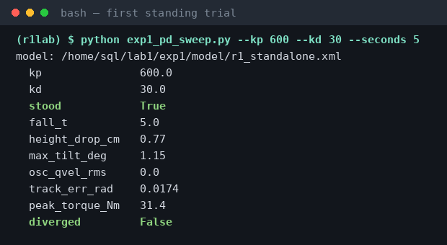
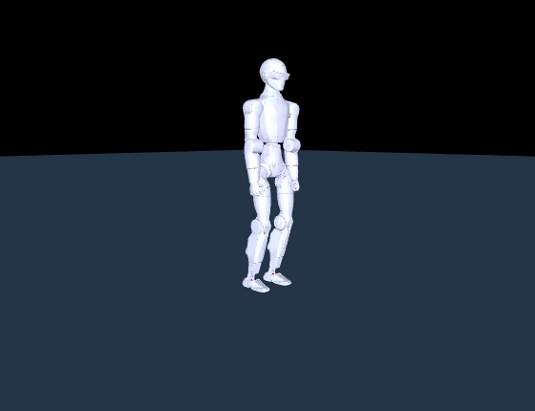
STEP 6 / 10
Run one good setting
make it stand once
I picked one setting I expected to work — a stiff spring, moderate damping — and ran a single 5-second trial.
▶ 6 s, real time — it holds the pose
stood = True. But look at track_err_rad = 0.0174 — the worst joint sits 1° away from where I told it to be, permanently,
even though it is standing perfectly. That number turned out to be the key to the whole experiment.

Slide 10
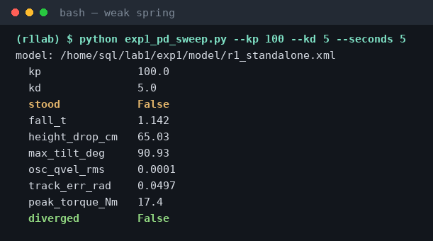
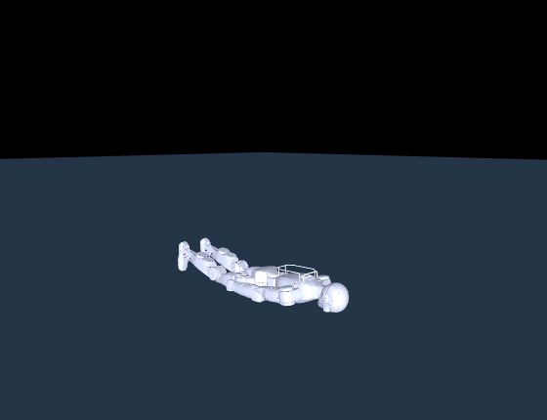
STEP 7 / 10
Break it — weak spring
the robot topples
Then I weakened the spring to see it fail — and watched what kind of failure it was.
▶ 4 s — it goes down at 1.14 s
It fell after 1.14 s, dropped 65 cm and tilted 91°. Every number is real and diverged is False — the physics worked fine.
And peak_torque was 17.4 Nm, LOWER than the successful run. It did not fall from lack of strength.

Slide 11
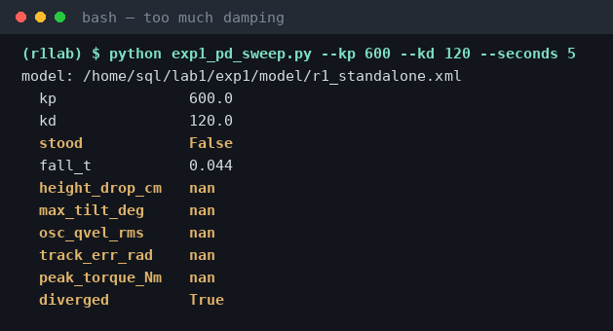
STEP 8 / 10
Break it — heavy damping
the simulator dies
Then I turned the damping way up — and got a completely different kind of failure.
THIS IS NOT THE ROBOT
Every measurement is nan —
“not a number”.
Nothing physical happened.
The simulator's arithmetic
ran away to infinity in
22 steps.
A real robot cannot do this.
I am watching my TOOL fail,
not my robot.
diverged is the field that separates the two failures. Learning to tell them apart is, honestly, the most useful thing I got from this experiment.

Slide 12
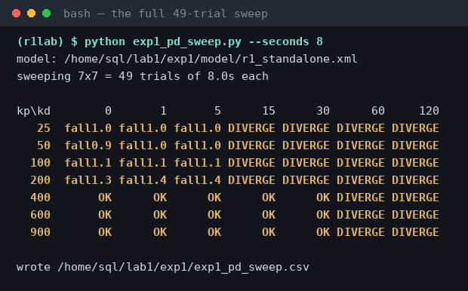
STEP 9 / 10
Sweep all 49 settings
map where standing is possible
With both failure modes understood, I ran every combination — 7 spring values × 7 damping values.
49 trials, 6 minutes
OK = stood 8 s
fallN.N = toppled
DIVERGE = sim blew up
15 stood
12 toppled
22 blew up
The most common outcome
was my simulator failing —
not the robot.

Slide 13
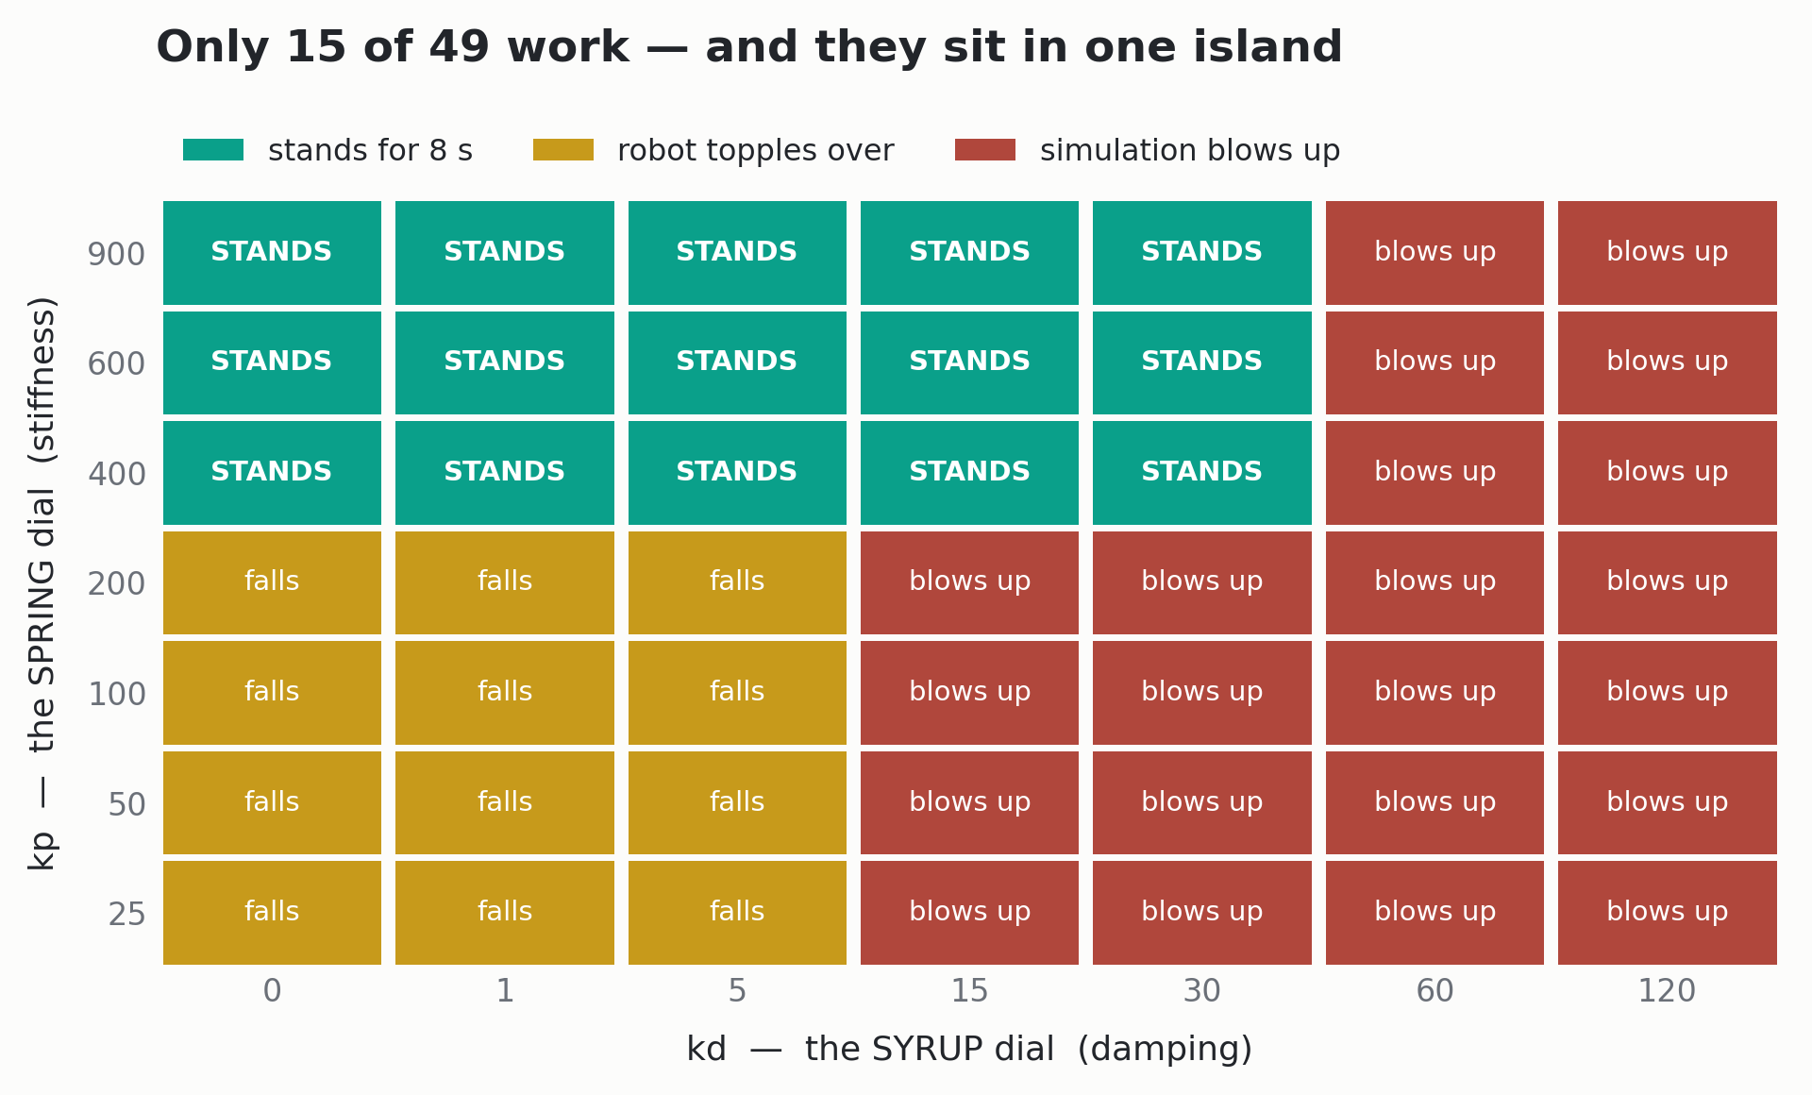
What the 49 trials look like as a picture
Same data as the previous slide, drawn on the two dials I was turning.
Standing is not “tune it until it works”. It is one island, with a floor below it and a ceiling above it.

Slide 14
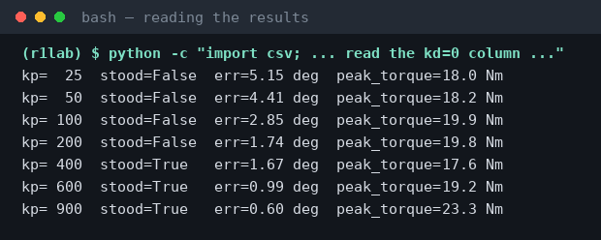
Why the floor is there
I pulled one column out of the CSV to see what was actually changing.
Double the spring,
halve the error.
A spring only pushes when
it is stretched. To hold the
robot up, a joint MUST sit
away from its target.
Weaker spring → bigger
permanent lean → the weight
line leaves the foot → it tips.
And the torque column never moves: 17–23 Nm whether it stood or fell.
The motors were never near a limit. The robot does not fall because it is weak — it falls because it is leaning. That distinction
is the single thing I most want to get across from this experiment.

Slide 15
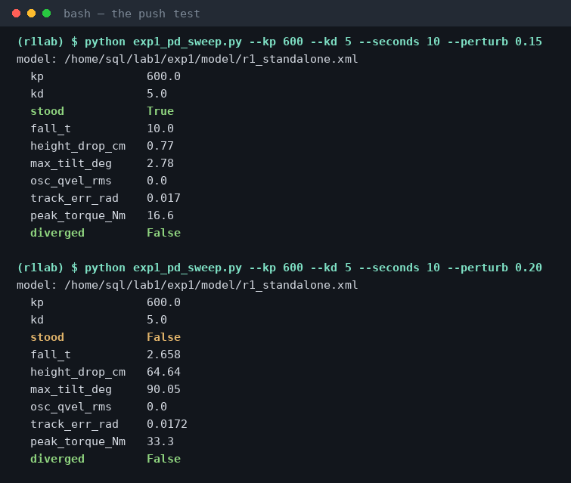
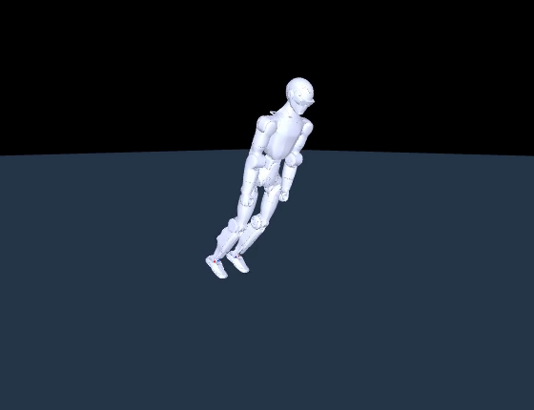
STEP 10 / 10
Push it over
find the limit I cannot tune away
Last step: I shoved the robot sideways one second in, and raised the shove until it fell.
0.15
holds
0.20
falls
▶ shoved at 0.20 m/s, one second in
0.20 m/s is
slower than
walking pace.
I ran this at kd = 5 on purpose — at kd = 30 the simulator dies before the robot falls.

Slide 16
Then I tried to fix it — and could not.
I went back through the settings looking for any pair that survives 0.20 m/s. There isn't one.
This controller only knows one instruction:
“get back to the pose I was told to hold.”
But recovering from a shove means choosing a DIFFERENT pose — stepping, bending, shifting weight.
Two numbers that scale “how hard to return to a fixed target” cannot express that decision. It is not a tuning problem.
That is the gap Experiment 2 fills — and the number it has to beat is 0.20 m/s.

Slide 17
What I found
✓
The robot can stand with no AI at all
15 of 49 settings hold it up for 8 seconds
✓
Standing lives in a bounded island
needs a stiff spring AND limited damping — a floor and a ceiling
✓
Falling is a balance problem, not a strength problem
torque never exceeded 23 Nm in any trial, standing or falling
✓
Most failures were my simulator, not my robot
22 of 49 cells were numerical blow-ups
✓
It cannot survive a 0.20 m/s push
and no choice of the two gains changes that
Everything above came off my own screen, in the order you just saw.

Slide 18
Two things I had to fix along the way
Rebuilding this from a blank machine exposed problems I did not know I had.
1 — It only ran on my laptop
2 — I was measuring the wrong thing
The script had my own home folder written
into it, pointing at a model stored in a
different project. On any other machine it
failed immediately.
Fixed: the model now travels with the
experiment, and the path is an option.
My push test used damping of 30. At that
setting the simulator dies before the robot
falls — so I was recording the tool's limit,
not the robot's.
Fixed: push tests now run at damping 5,
well inside the safe zone.
Both bugs had the same shape: something worked on my machine, so I never questioned it.
Re-running the whole thing on a clean install is what surfaced them. I would not have found either one by re-reading my code.
Reproducibility check: this whole experiment reran on MuJoCo 3.12 and NumPy 2.4 — four major versions newer than I developed it on —
and every physics number came out identical.

Slide 19
Where this goes next
Experiment 1 gave me a baseline. Experiment 2 has to beat it, measured exactly the same way.
EXPERIMENT 1 — no learning
EXPERIMENT 2 — trained policy
survives 0.15 m/s
falls at 0.20
survives 0.30 m/s
falls at 0.40
Same robot, same shove, same measurement — the only thing that changed is what decides the pose.
Questions

